Slide 1


Late Purushottam Hari (Ganesh) Patil Shikshan Sanstha’s
Mauli Group of Institution’s
College of Engineering and Technology Shegaon.
Project Name:
Image Caption Generator with CNN & LSTM
Submitted By :
1. Pallavi Tayde
2. Prerna Dabhade
3. Megha Chopade
4. Sham Johari
5. Sanjay Junare
Guided By : Dr. P. M. Hasabnis
Department of Computer Science and Engineering
Session 2022-23

Slide 2
CONTENTS
Problem Statement
Introduction
Literature Review
Technologies
Flow Diagram
Advantages
Project Plan

Slide 3
PROBLEM STATEMENT
You saw an image and your brain can easily tell what the image is about, but can a computer tell what the image is representing?

Slide 4
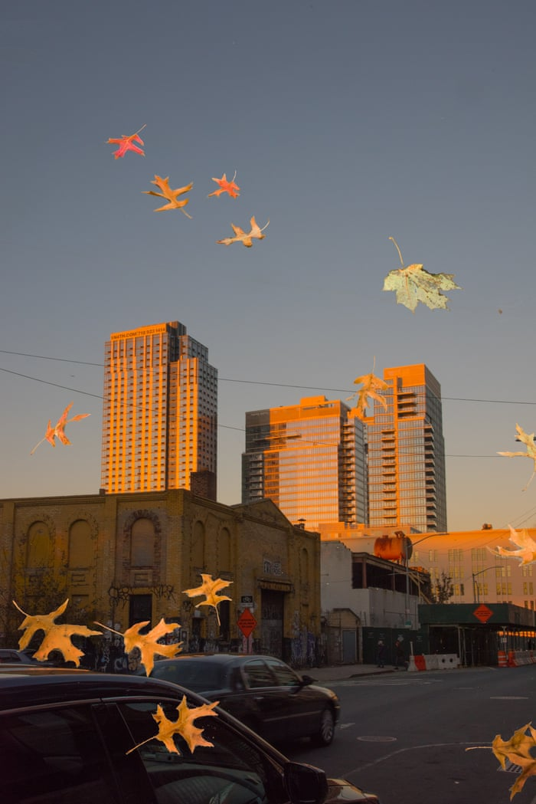
INTRODUCTION
Photograph captioning is the process of making a description for an
image.
Caption generator project can be done through various techniques
like convolutional neural network (CNN), long short-term memory
(LSTM) and recurrent neural network (RNN).
Image caption may generate subtitles for any pixel in a
monochrome or color image.
City in golden hours!

Slide 5
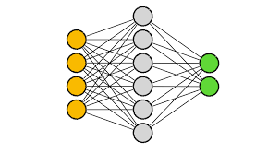
Image Caption Generator - Techniques
Image caption generation can be done by using following techniques:
CNN
RNN
LSTM

Slide 6
Convolutional Neural Network
CNN (Convolutional Neural Network) is specialized deep neural networks which process the data and is used for the recognition and classification of images.
It scans the images from left to right and top to bottom and extracting relevant features from them.
Finally, it combines all the features for image classification.
It can handle the images that have been translated, rotated, scaled and changes in perspective.

Slide 7
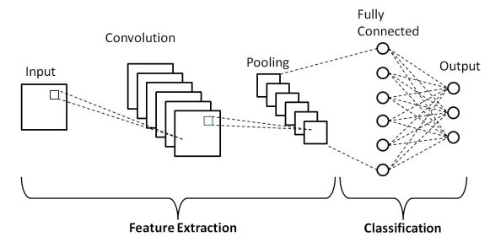
Fig. Convolutional Neural Network (CNN)

Slide 8
Recurrent Neural Network
Recurrent Neural Networks (RNNs) is commonly used in image caption generators to generate captions for images.
The basic idea to use an RNN to generate a sequence of words that describe the image.
Combining CNNs and RNNs helps us work with images and sequences of words in this case.

Slide 9
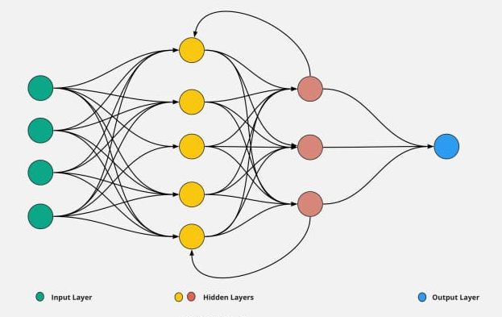
Fig. Recurrent Neural Network (RNN)

Slide 10
Long Short – Term Memory
LSTM (Long short-term memory) is a type of RNN which is capable of working with sequence prediction problems.
It is used for the next word prediction purposes, as in Google search, our system is showing the next word based on previous text.
LSTM is used to carry out relevant information and to discard non-relevant information.

Slide 11
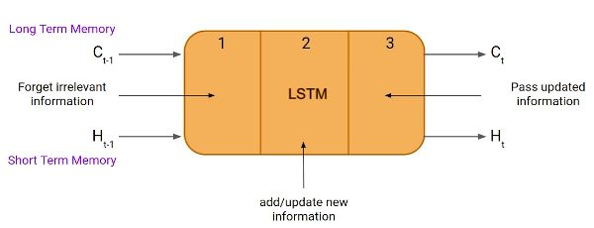
Fig. LSTM cell

Slide 12
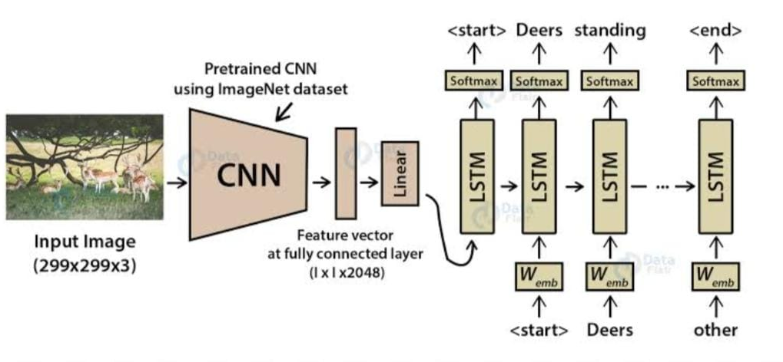
MODEL – IMAGE CAPTION GENERATOR
Output Caption : Deers are resting!

Slide 13
LITERATURE REVIEW
Author | Title of Paper | Work | Year
1. M. Pranay Kumar, V. Snigdha, R. Nandini, Dr. B. Indira Reddy. | Image Captioning Generator Using CNN and LSTM | The paper proposes an image captioning approach that uses a combination of CNN and LSTM networks with an attention mechanism. | 2022
2. Rohit Pawar, Omini Jadhav, Rutuja Nalage. | Image Captioning Generator Using CNN and LSTM (GUI Application) | The paper presents an image captioning application that uses a pre-trained CNN and LSTM to generate captions for input images. And develop a user-friendly GUI that allows users to input an image and view the generated caption. | 2022
3. J.A. Alzubi, R. Jain, P. Nagrath. | Deep image captioning using an ensemble of CNN and LSTM based deep neural networks | The paper suggests using a combination of CNN and LSTM based DNN to generate captions for images by training multiple models on the same dataset and combining their outputs. | 2021

Slide 14
TECHNOLOGY USED
HARDWARE REQUIREMENTS:
1. Computer System.
2. Active Internet Connection.
SOFTWARE REQUIREMENTS:
Windows 10/11
Python Libraries
Google Collaboratory

Slide 15
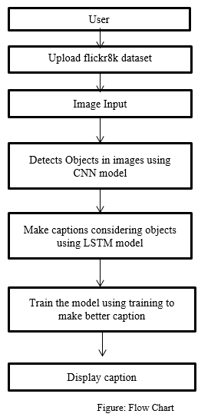
FLOW DIAGRAM

Slide 16
ADVANTAGES
Image caption generator can enhance the user experience of websites, social media platforms, and other applications.
It is more accessible to people who are visually impaired.
It can save the time by automatically generating textual descriptions of images instead of requiring manual input from human users.
It can increase engagement with the image and improve the overall user experience.

Slide 17
PROJECT PLAN
Sr.no | Work | Period
1 | Topic Decided | 21 Feb to 25 Feb
2 | Abstract Submitted | 8 Mar to 10 Mar
3 | Searched out the latest Technologies on our topic | 11 Mar to 15 Mar
4 | Study of research papers | 16 Mar to 21 Mar
5 | Decided two technologies CNN, LSTM | 22 Mar to 26 Mar
6 | Working for first phase | 27 Mar to 2 April
7 | First phase | 3 April
FUTURE PLAN
Working on CNN Working on LSTM Research paper will be published Preparation of second phase All the limitation of first phase we will be cover in the second phase.

Slide 18
Thank You…

